Slide 1


Decentralized Wall Street
2018
2019

Slide 2



+
Current Problem
International trading is only accessible through centralized derivatives trading platforms
Highly frictional
High fees
Lack of asset variety

Slide 3





Equities & Indices
S & P 500
NASDAQ Composite
Cryptos
BTC/CAD
ETH/CAD
Blockchain + Bloomberg + NASDAQ
Foreign Currency
USD/JPY
USD/CAD
Commodities
Oil Price
Gold Price

Slide 4






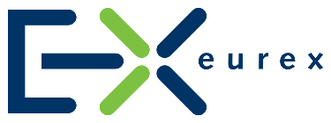


Centralized Platforms
Decentralized Platforms
VS
511232733
511232733
511232733
511232733
511232733
511232733
Slow Withdraw
High Transaction Fee
Lack of Derivatives
Network’s
High TPS
Low Transaction Fee
P2P
Trading

Slide 5



Yesbit Blockchain Protocol
2 Ways of Data Obtaining
Proof of Data
Proof of Data brings the reliable data feed onto the network.
Blockchain + Bloomberg + NASDAQ
Proof of Work
Derivative contracts are processed via Proof of Work to ensure blocks are mined efficiently.

Slide 6





Data Feed
51% Consensus Super Nodes




Thomson Reuters
NASDAQ
Bloomberg
NYSE

Slide 7

2
Yesbit uses a cold storage system to secure users funds.
Crypto Wallet
Multi-signature Wallet
1
User has 100% ownership of their digital assets, unlike centralized platform.

Slide 8


Use Case
Commodity Contract
Julia created a commodity contract for 1 ETH.
Longing Gold Price
She will win 0.1 ETH of her contract, her balance is now 1.1 ETH.
Gold
went up by 10%
Gold Price
Market Index Contract
Sam paid 10 Tokens for a market index contract. Longing NASDAQ Index
NASDAQ
went up by 5%
He will gain 0.5 Tokens of his contract, his balance is now 10.5 Tokens.
NASDAQ

Slide 9




Demographic
Geographic
Age: 18-45
Gender: 80% Male
20% Female
Income: Under 200,000 USD
No geographical boundaries: users just need an internet connection.
Market Segmentation
Behavioral
Psychographic
Affinity for high risk
Propensity to be early adopters
Interest in technology
Not complacent: always trying to push new boundaries.
Take calculated risks.

Slide 10
Advertising
Experiential Marketing
Podcast Sponsorship
Press Release
Seminars at University Campuses/ Community Organizations
Pop-up shops focused on increasing awareness
Integrated Marketing Mix
Sales Promotion
Digital Marketing
Referral Program
Affiliate Marketing
SEM & SEO
Public Relations
Social Media / Influencer Marketing

Slide 11

Revenue Streams
Targeting 2.5% for Yesbit user
25,764,015*
Total Crypto Users
$2,576,400
$3,435,200
Overnight Interest
Transaction Fee
$6,011,600
Total Revenue
* Statista, 2018

Slide 12

Road Map
Centralized Beta Version
Decentralized ETH DAPP
Alpha Blockchain
Beta Yesbit Blockchain
Decentralized Data Source
Front-End UI
Main-Net Launch
June
July
Aug
Sep
Oct
Nov
Dec
Jan
Feb
Mar
Apr
May
June
2018
2019

Slide 13


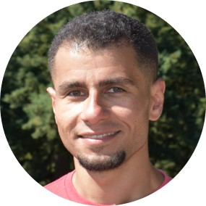



Team Members
Team has successfully launched an OTC Crypto trading platform linkcoin.pro in December 2017,
LinkCoin has accumulated 300,000 USERS till October 2018.
Blues Qin
CEO & CTO
Arthur Ye
Director of Business Development
Remon Nashid
Blockchain Developer
Lee Raj
Smart Contract Developer
Miao Jiang
Blockchain Developer
Richard Qin
Full-Stack Developer

Slide 14






Team Members
Team has successfully launched an OTC Crypto trading platform linkcoin.pro in December 2017,
LinkCoin has accumulated 300,000 USERS till October 2018.
Estrella Li
Marketing Lead
Leon Tang
Product Design
Sharon Yu
Front-End Designer
Jonah Mirsky
Digital Marketing
Zhaoan Lin
Developer
Baldwin Yuen
Digital Marketing

Slide 15


Decentralized Wall Street
www.yesbit.io
Business Powerpoint Template
015

